Slide 1
systems analysis
Developing User Requirements

Slide 2
Topics
Users
User classes
User stories
User personas
Use cases
UML diagrams in use cases

Slide 3
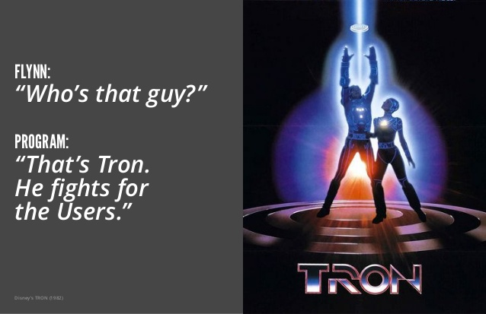
Who Cares about Users?

Slide 4

Why Care about Users?
Customer involvement is a critical factor in delivering excellent software
Successful requirements gathering, and hence successful software development, depends on getting the voice of the user close to the ear of the developer

Slide 5
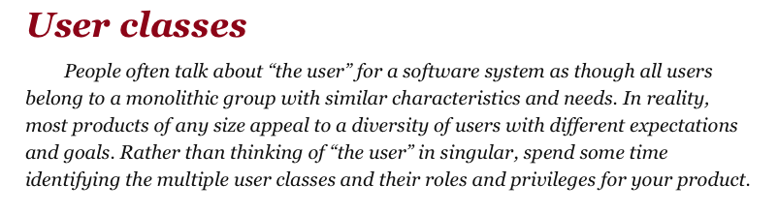
Finding the Voice of the User
Identify the different classes of users for your product
Select and work with individuals who represent each user class
Agree on who the requirements decision-makers are for your product

Slide 6
Classifying Users
You can group users into a number of classes based on such differences as:
Their access privilege or security levels (such as ordinary user, guest user, administrator)
The tasks they perform during their business operations
The features they use
The frequency with which they use the product
Their application domain experience
Their computer expertise
The platform they will be using (desktop, laptop, tablet, smartphone, specialized device)
Their network bandwidth requirements
Their Quality of Service (QoS) requirements
etc.

Slide 7
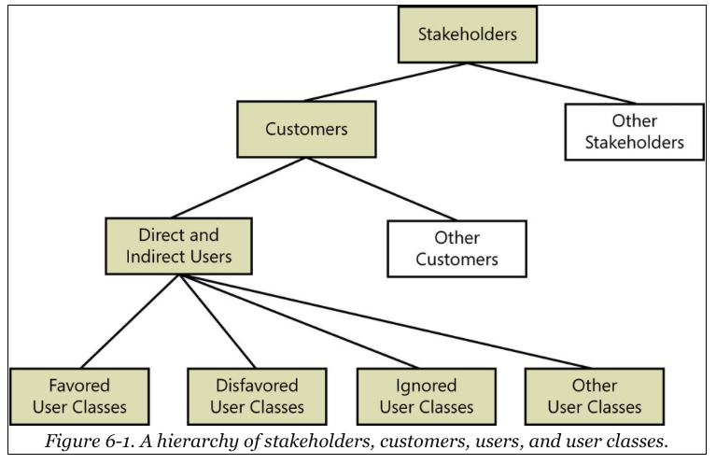
Hierarchy of Stakeholders

Slide 8
Classifying Users (continued)
Stakeholder Type | Description
Favored User Classes | Those whose satisfaction is most closely aligned with achieving the project’s business objectives
Disfavored User Classes | Those who aren’t supposed to use the product for legal, security, or safety reasons
Ignored User Classes | Those who may use the product, but you aren’t specifically building the product to suit them
Other User Classes | Project-dependent

Slide 9
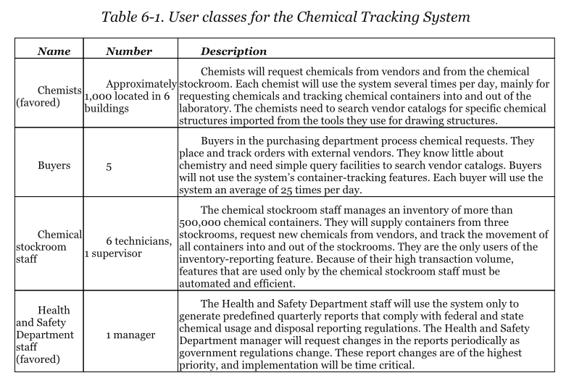
User Classes Example

Slide 10



Product Champion
A key member of the user community who provides requirements
Serves as the primary interface between members of a single user class and the project’s Business Analyst
Has a clear vision of the new system and enthusiasm for it
Should be an effective communicator

Slide 11
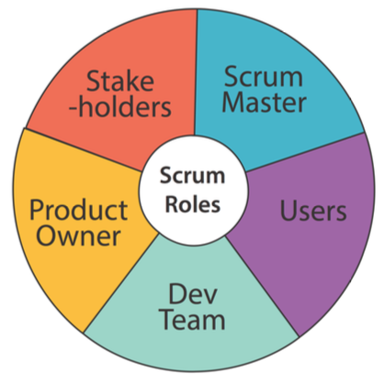
Product Owner
Agile team member who defines the product’s vision
Represents the user to the team
Develops and prioritizes contents of the product backlog
The backlog is the prioritized list of user stories (requirements) for the product and their allocation to upcoming iterations (sprints)

Slide 12
Agile User Stories (Review)
User stories have a specific format:
As a [persona],
I want to [do something],
so that I can [realize a reward]
Examples:
As Helen the HR Manager, I want to screen an engineering candidate, so I know their skills profile.
As a customer, I want to withdraw cash from an ATM, so that I don't have to wait in line at the bank.

Slide 13


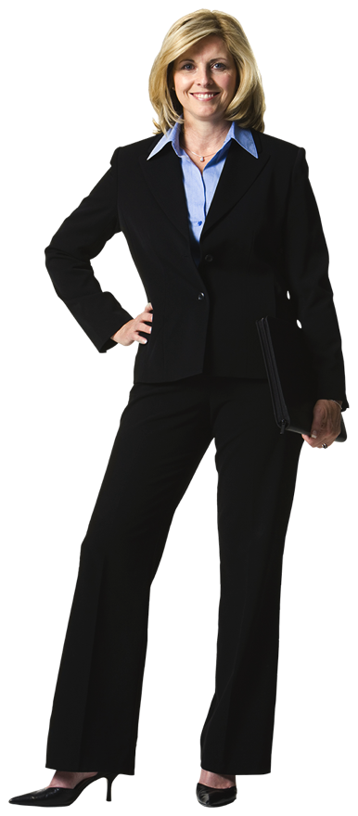
Agile User Personas
A description of a hypothetical generic person who serves as a stand-in for a group of users who have similar characteristics and needs
Personas help you understand the requirements and to design the user experience to best meet the needs of specific user communities

Slide 14
The Three C’s for Discovering User Stories
Cards – Token for conversation with users
Conversation
Who wants What and Why
Facts and info to help you recall the conversation
What the user will be doing
The context in which the user will be doing things
What can go wrong?
Confirmation – Acceptance tests

Slide 15

Characteristics of a Good User Story
Independent
Negotiable
Valuable
Estimable
Small
Testable

Slide 16
Use Cases
A use case is “a description of a set of logically related possible interactions between an actor and a system that results in an outcome that provides value to the actor. Can encompass multiple scenarios.”
Source: Software Requirements, Third Edition by Karl Wiegers and Joy Beatty (Microsoft Press, 2013)
A use case is “a list of actions or event steps typically defining the interactions between a role (known in the Unified Modeling Language as an actor) and a system to achieve a goal. The actor can be a human or other external system.”
Source: Wikipedia

Slide 17
Use Case Actor
A person (or sometimes another software system or a hardware device) that interacts with the system to perform a use case
More specific than a user or user class, focused on an action
Examples:
Requester
Buyer
Patron
Cafeteria Staff Person
A use case must have a primary actor, may have a secondary actor

Slide 18
The Purpose of Use Cases
Both use cases and user stories shift from the product-centric perspective of requirements elicitation to discussing what users need to accomplish
Instead of asking users what the system should do, ask the users what they need to do
CAVEAT: User stories and use cases may not work well for exploring the requirements for non-user-focused tasks:
Batch processes
Backend systems
Computationally intensive systems
Data warehousing
Embedded systems

Slide 19
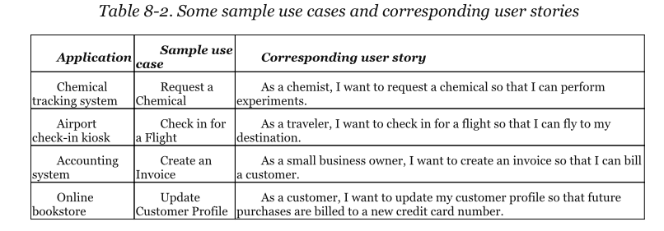
Comparing Use Cases and User Stories

Slide 20
A Picture Is Worth a 1024 Words
Unified Modeling Language (UML) or other diagramming systems can be very helpful additions to use cases
UML is a general-purpose modeling language used to visualize many different aspects of software and software development
There are many types of UML diagrams:
Use case
Activity
Class
State
For more info see Chapter 12 of our textbook and https://www.smartdraw.com/uml-diagram/

Slide 21
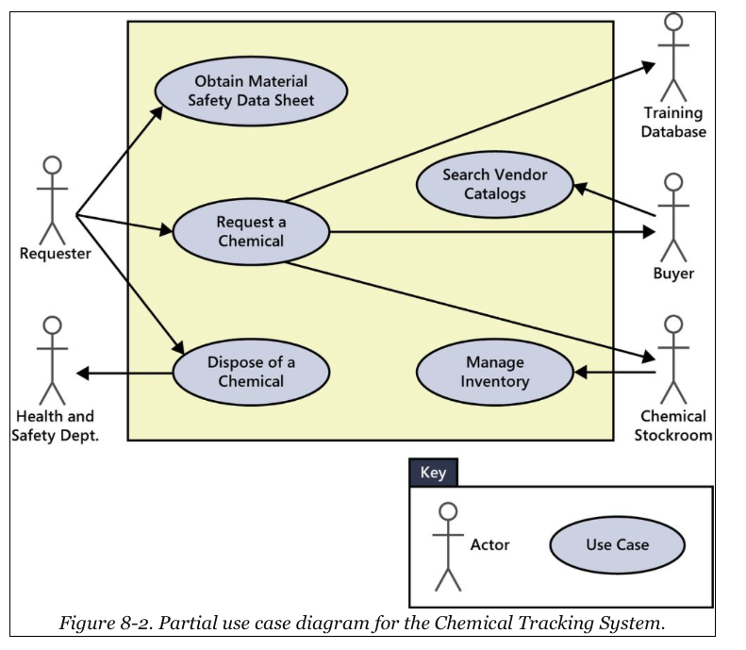
UML Use Case Diagram Example

Slide 22
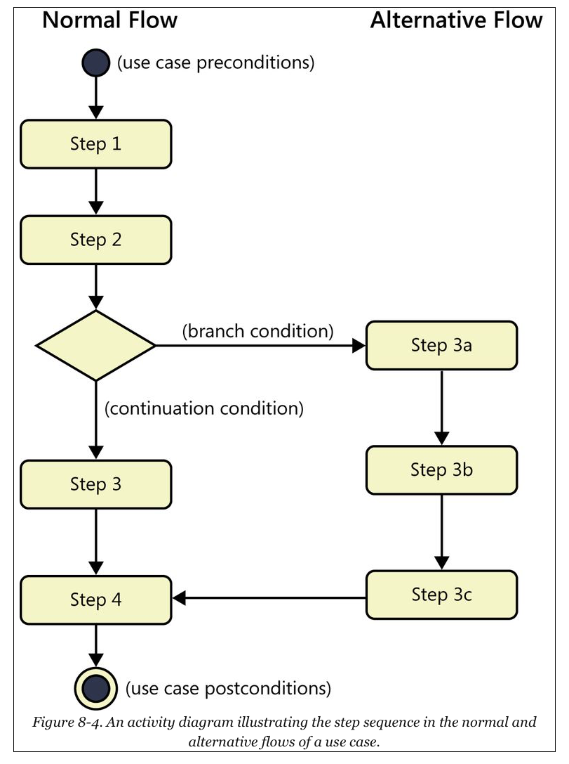
UML Activity Diagram Example

Slide 23
Writing Use Cases
A use case describes a sequence of interactions between a system and an external actor that results in the actor being able to achieve some outcome of value
The name of a use case is always written as
VERB OBJECT
Examples:
Request Chemical
Print Material Safety Data Sheet
Create Invoice
Buy Item

Slide 24
Use Case Components
Unique ID
Name in VERB OBJECT format
Brief description that specifies the purpose of the use case
A trigger condition that initiates execution of the use case
Zero or more preconditions that must be satisfied before the use case can begin
One or more postconditions that describe the state after the use case has successfully completed
The normal flow represented as a numbered list of steps that shows the sequence of interactions between the actor and the system

Slide 25
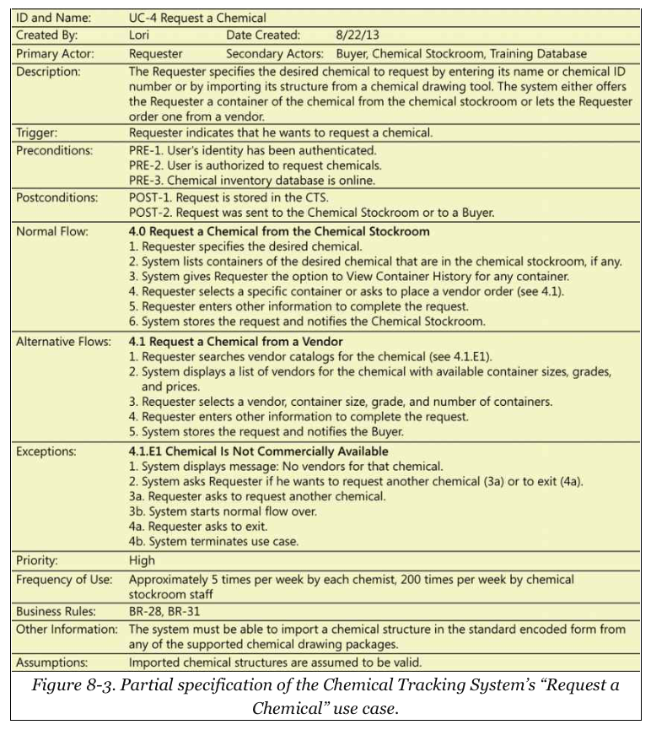
Use Case Example

Slide 26
Summary
In this module, we talked about:
The importance of listening to users
Classifying users
Developing user stories, user personas, and use cases
Adding diagrams to your use cases

